Slide 1



Slide 2

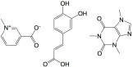
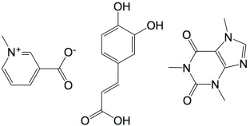

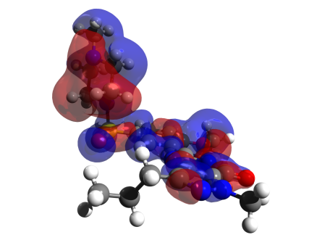
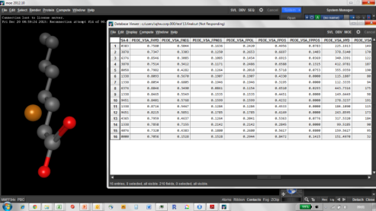
Reported activity
#Molecule/effect
#1/57%
#2/22%
#3/81%
…
Forecast
machine
#541 -> 57%
#342 -> 22%
#343 -> 81%
formulas
Machine
Learning :
Learn from the machine
Simulated molcules
MLR
PCR
PLS
ridge
PCR
kNN
RF
SVM
ANN
Properties of
molecules
?

Slide 3
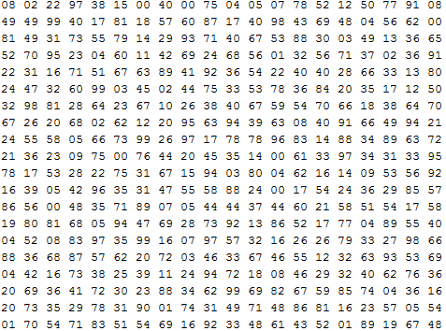


Model-fit
Supervised-learning:
GLM
PLS
Ridge
Model
kNN
Xy-train
RF
Deep
neural
nets
Training parameters
Hyper parameters
P(‘Søren’)=93%

Slide 4
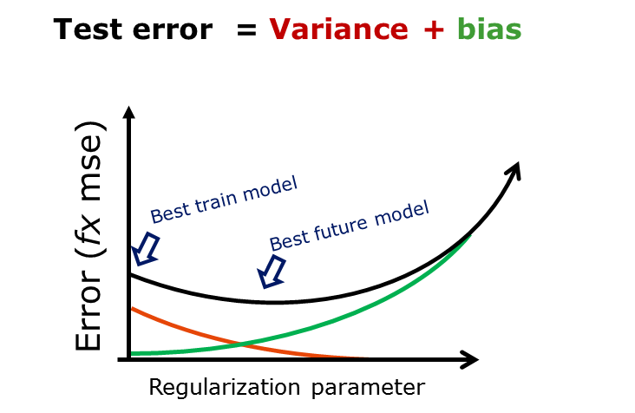
Test error = Variance + bias
Best train model
Error (fx mse)
Best future model
Regularization parameter

Slide 5
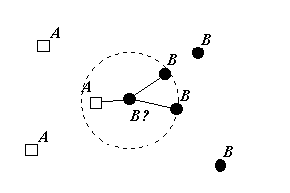
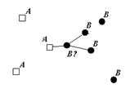
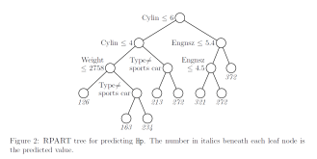
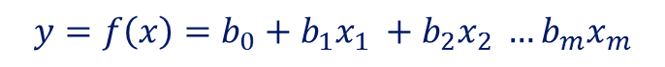
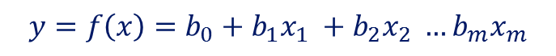
OLS
GLM
$$y=f\left(x\right)=b_{0}+b_{1}x_{1} +b_{2}x_{2} …b_{m}x_{m}$$
PLS
Ridge
“Apparent model”
PCs, constraints
$$y=f\left(x\right)=b_{0}+b_{1}x_{1} +b_{2}x_{2} …b_{m}x_{m}$$
kNN
RF

Slide 6
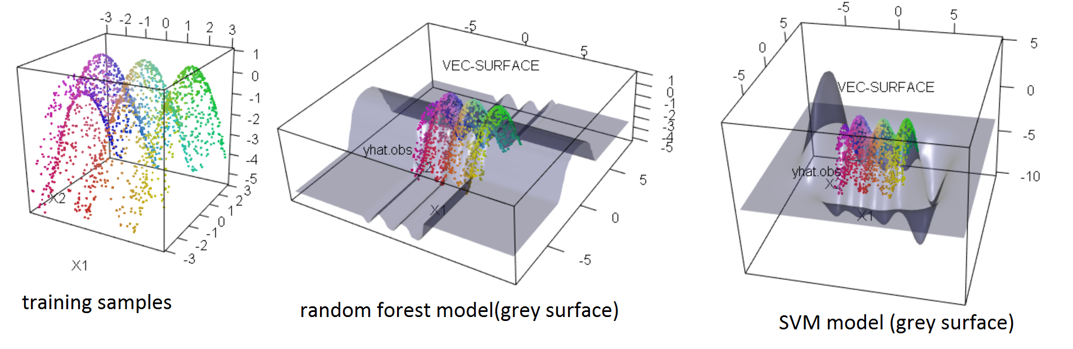
Random forest – support vector machine

Slide 7
RF vs SVM (3D example)
library(randomForest) #randomForest
library(e1071) #svm
library(forestFloor) #vec.plot and fcol
library(rgl) #plot3d
#generate some data
X = data.frame(replicate(2,(runif(2000)‐.5)*6))
y = sin(X[,1]*pi)‐.5*X[,2]^2
plot3d(data.frame(X,y),col=fcol(X))
#train a RF model (default params is nearly always, quite OK)
rf=randomForest(X,y)
vec.plot(rf,X,1:2,zoom=3,col=fcol(X))
#train a SVM model (with some resonable params)
sv = svm(X, y,gamma = 1, cost = 50)
vec.plot(sv,X,1:2,zoom=3,col=fcol(X))

Slide 8
RF vs SVM (2D example)
library(randomForest) #randomForest
library(e1071) #svm
library(forestFloor) #vec.plot and fcol
library(rgl) #plot3d
#generate some data
X = data.frame(replicate(2,(runif(2000)‐.5)*6))
y = sin(X[,1]*pi)‐.5*X[,2]^2
plot3d(data.frame(X,y),col=fcol(X))
#train a RF model (default params is nearly always, quite OK)
rf=randomForest(X,y)
vec.plot(rf,X,1:2,zoom=3,col=fcol(X))
#train a SVM model (with some resonable params)
sv = svm(X, y,gamma = 1, cost = 50)
vec.plot(sv,X,1:2,zoom=3,col=fcol(X))

Slide 9
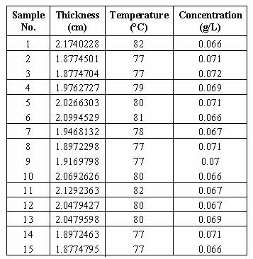

How to learn from the machine
Sample
data
Have machine
to model data
Unknown
system
Learn from
model
Bottom-up model selection
Unknown
system
Sample data
Fit explicit model e.g.
linear regression
Look at residuals
Add more terms or transformations
Test hypotheses of G
Simple model
Best model

Slide 10
Domain knowledge
of system
Few observations
Well-known system
Stick to bottom-up!
Many observations
Well-known system
Maybe for fine tuning.
N, observations
Few observations
Unknown system
Tough luck
Many observations
Unknown system
Machine Learning &
Data mining!

Slide 12
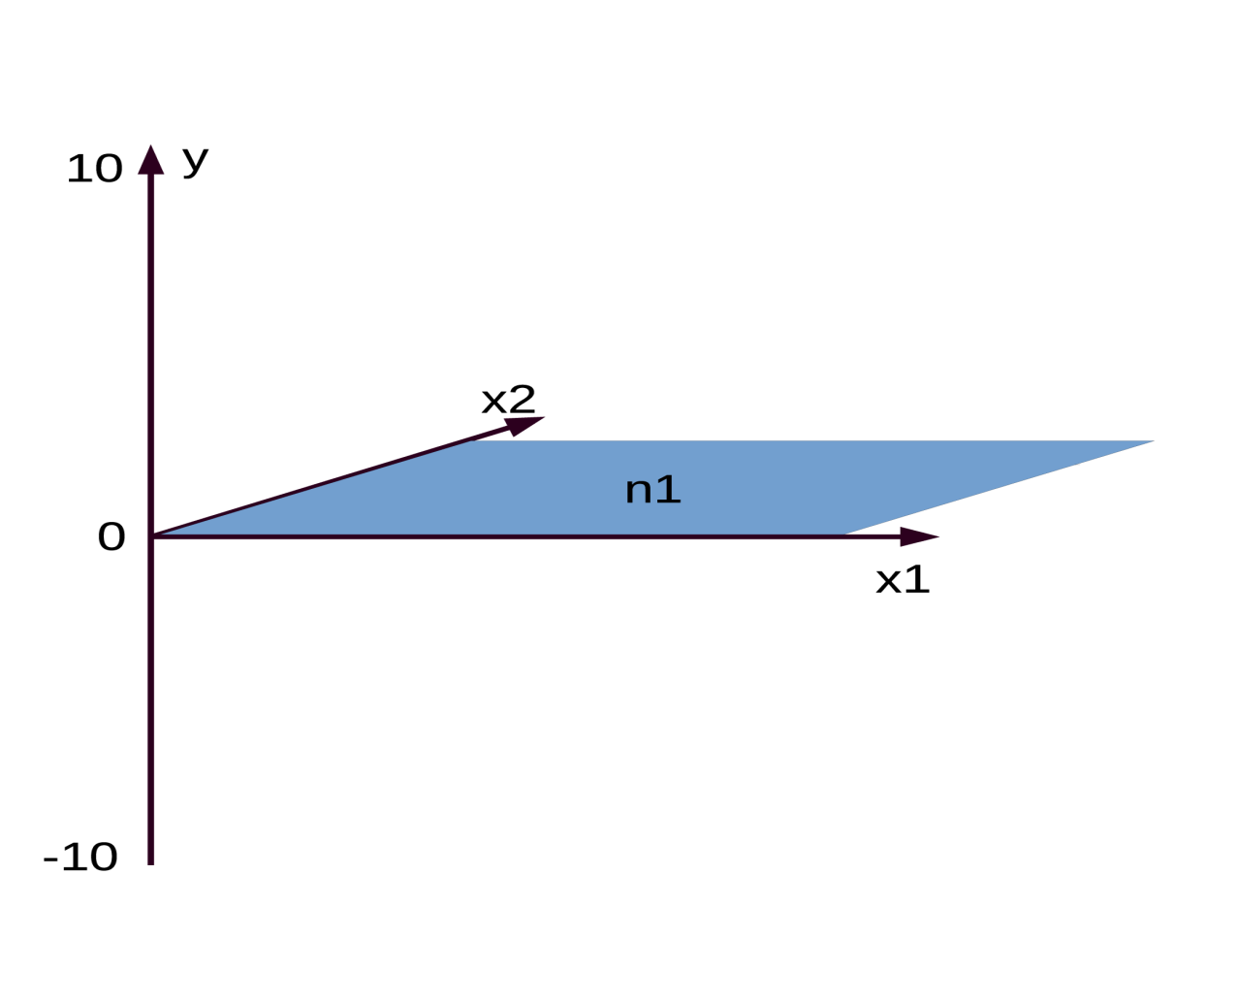
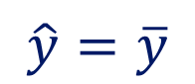
Two variables, one target, one grand mean(n1)
Mean is the prediction
$$\hat{y}=\overline{y}$$

Slide 13
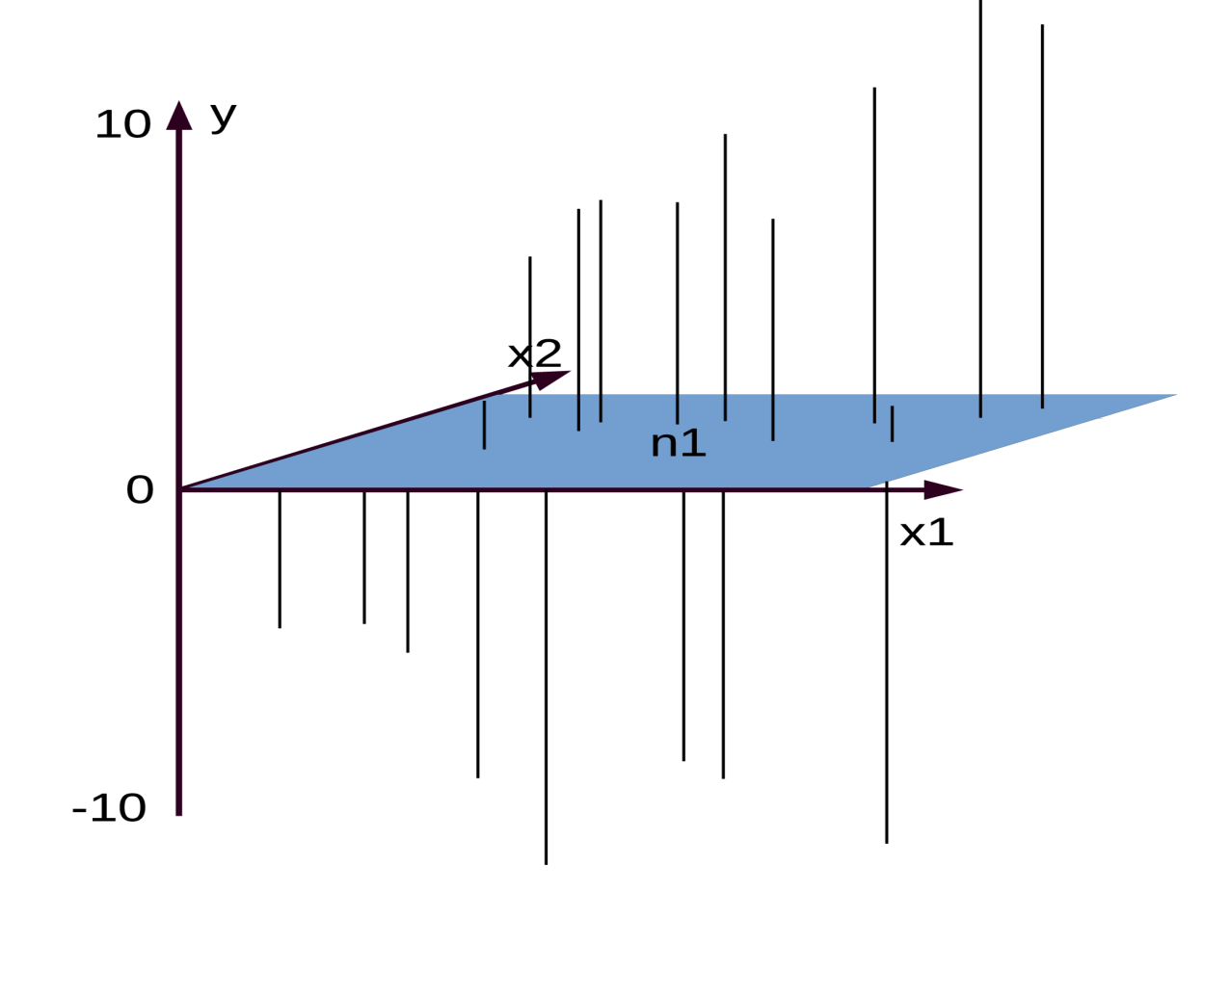
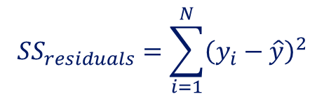
… and residuals of the grand mean
Sum of squares is error
$$SS_{residuals}=\sum_{i=1}^{N}{{\left(y_{i}−\hat{y}\right)}^{2}}$$

Slide 14
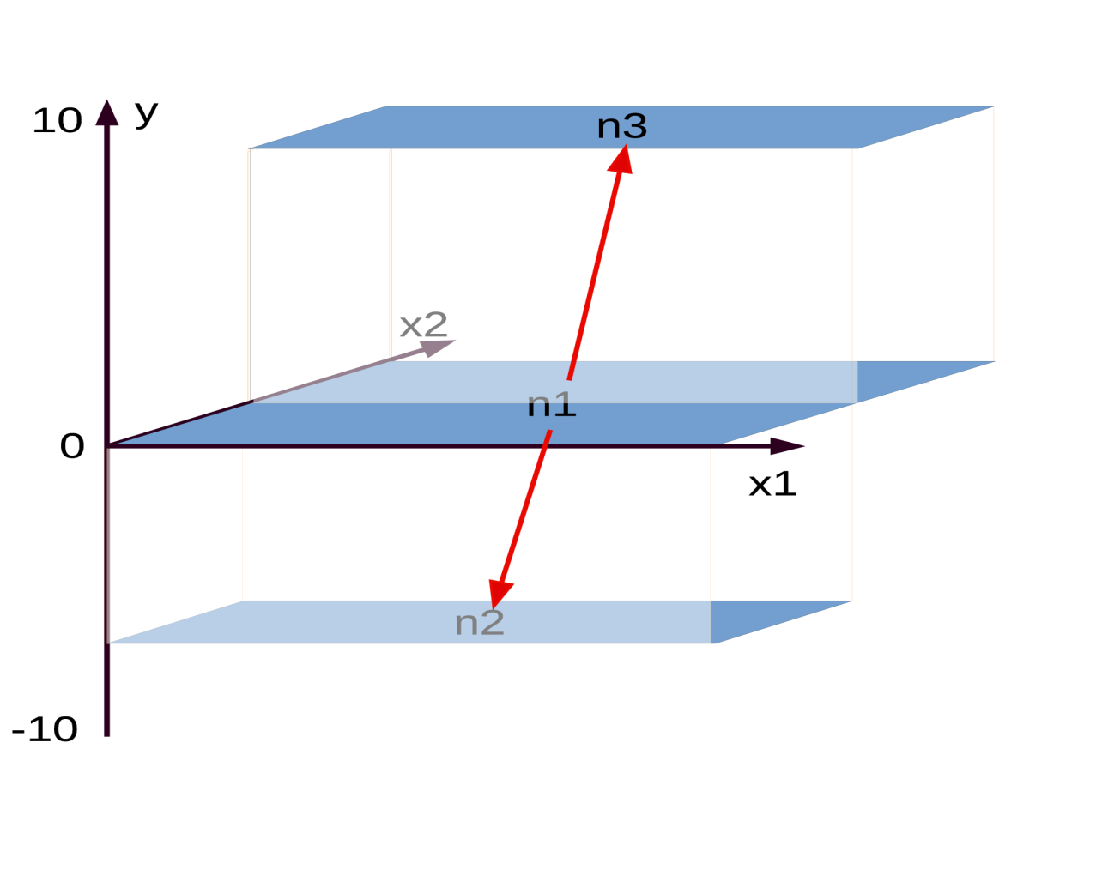
Best split of n1 by x2…
Best split gives lowest error

Slide 15
Best split of n1 by x2…
Repeat for each sub node!

Slide 16
Best split of n1 by x2…

Slide 17
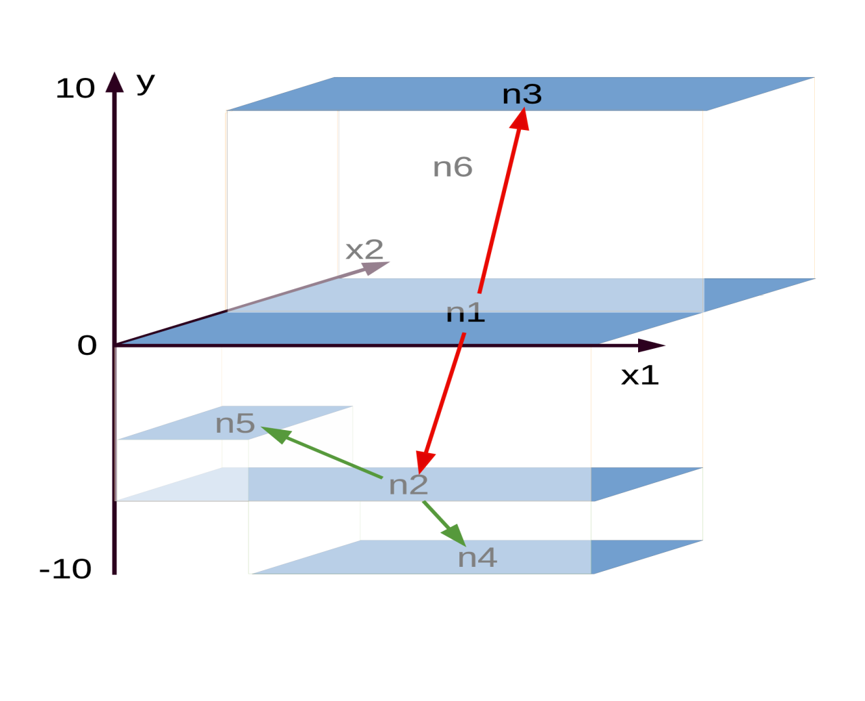
Best split of n2…

Slide 18
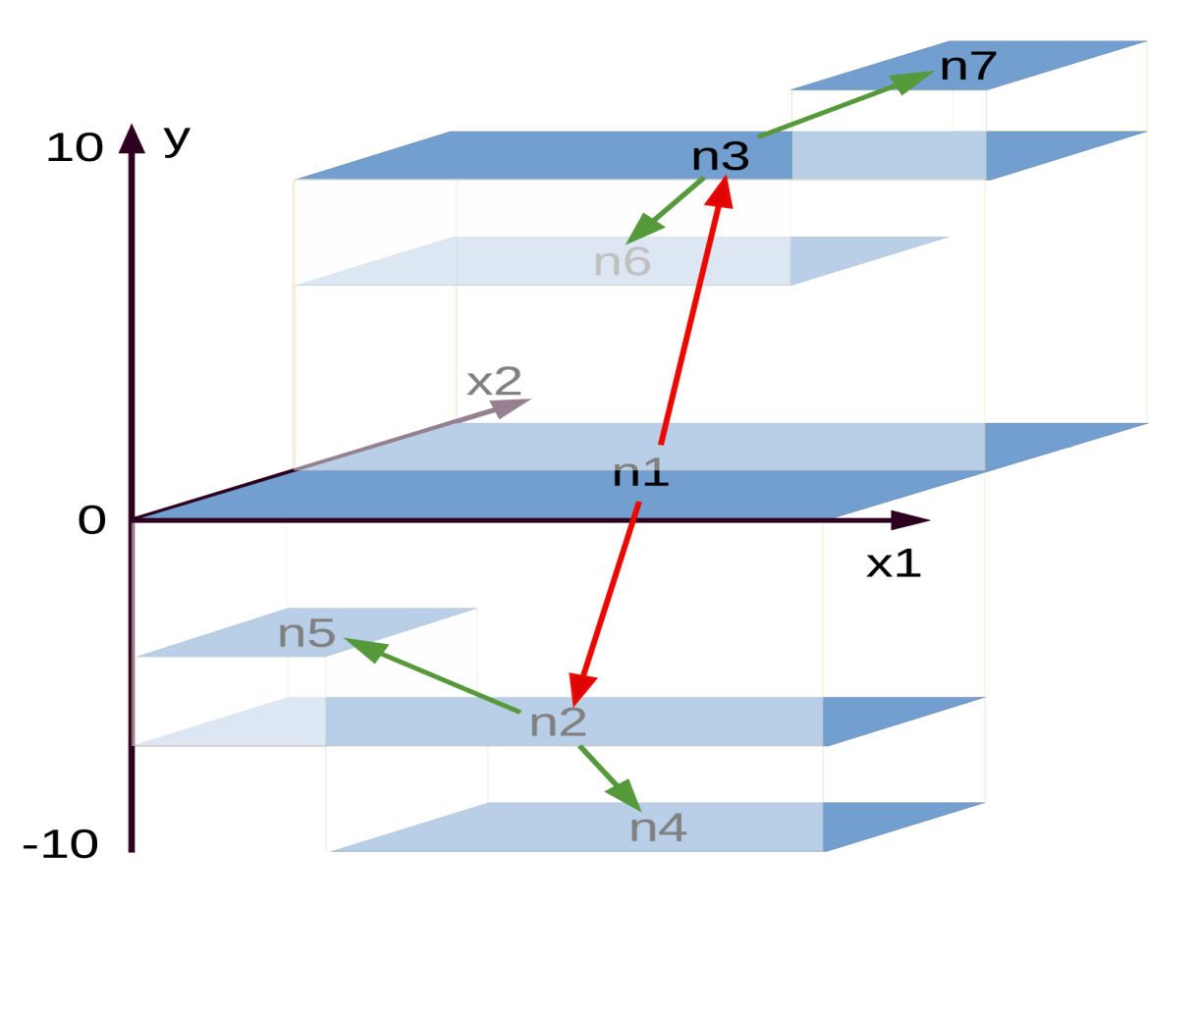
Best split of n3

Slide 19
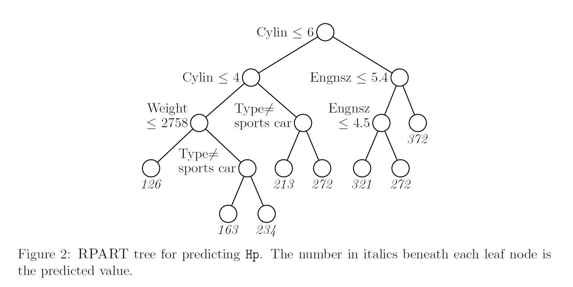

Slide 20
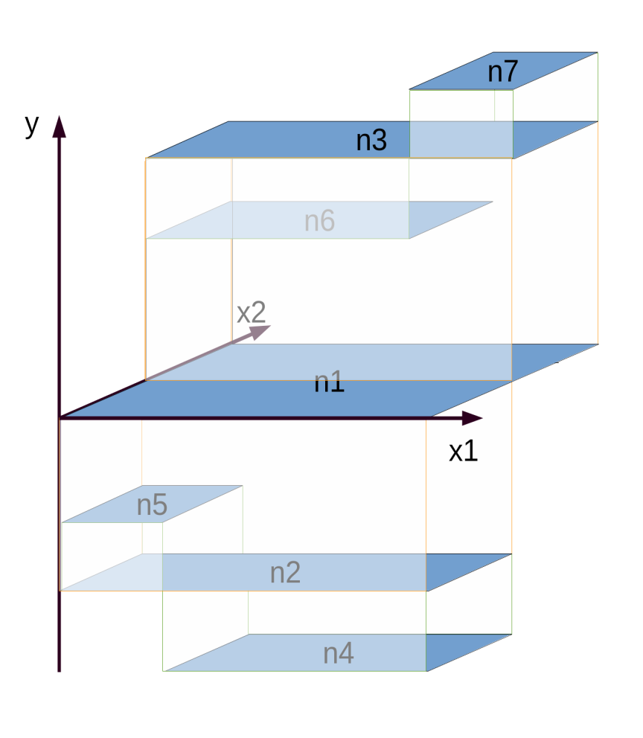
data
sampsize
ntree
bootstrap
mtry
nodesize

Slide 21


Slide 22
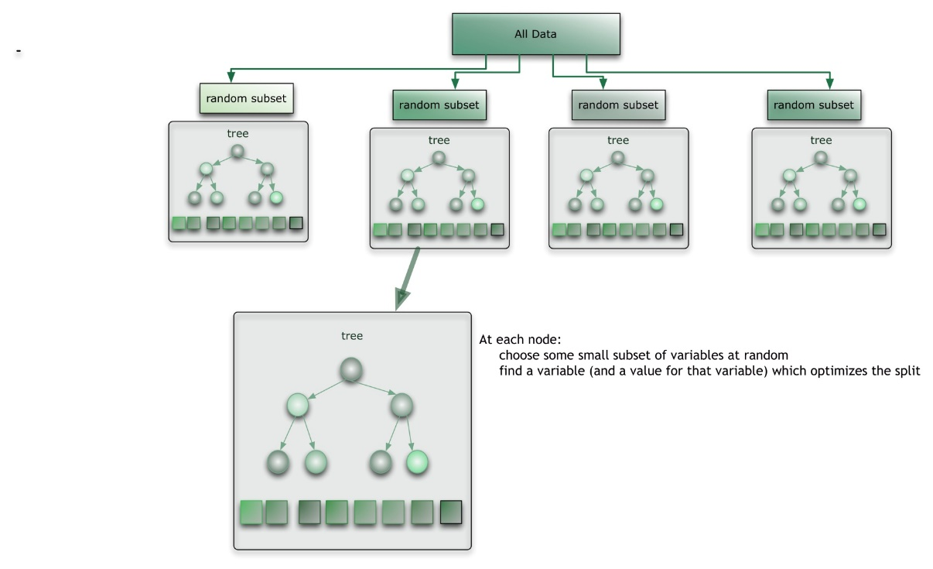

Slide 23
One fully grown tree works great!, when no noise
library(forestFloor)
library(randomForest)
library(rgl)
#make data
X = data.frame(replicate(2,runif(2500)-.5))
y = -X[,1]^2 -X[,2]^2
#make color vector/gradient by y vector
ycolor = fcol(y,RGB = F,alpha=1)
plot(X,col=ycolor)
#or plot in 3D
plot3d(x= X[,1],y= X[,2],z= y,col = ycolor,size=6)
#train one single tree
rf = randomForest(x=X,y=y,ntree=1)
#getTree
Tree = getTree(rf,k=1)
class(Tree)
dim(Tree)
Tree[1:50,]
#function to plot surfaces or slices of model structures
vec.plot(model=rf,X=X,i.var=1:2,col=ycolor,grid.lines = 200)
dev.new()
par(mfrow=c(1,2))
for(i in 1:2) vec.plot(model=rf,X=X,i.var=i,col=ycolor,grid.lines = 1000,
main=paste("2D slice of model structure var:",i))

Slide 24
When one fully grown tree works terribly!
#single fully grown trees sensitive to noise
#make data
X = data.frame(replicate(2,runif(2500)-.5))
y = -X[,1]^2 -X[,2]^2 +rnorm(2500)*.1
Xtest = data.frame(replicate(2,runif(2500)-.5))
ytest = -Xtest[,1]^2 -Xtest[,2]^2+rnorm(2500)*.1
ycolor = fcol(y,RGB = F,alpha=1)
plot3d(x= X[,1],y= X[,2],z= y,col = ycolor,size=6)
#train one single tree
rf = randomForest(x=X,y=y,ntree=1,nodesize=1)
open3d()
vec.plot(model=rf,X=X,i.var=1:2,col=ycolor,grid.lines = 200)

Slide 25
Try to search for best node size for one tree
#vector of different nodesizes
nodesizes = c(1:15,ceiling(seq(20,1500,length.out=100)))
#iterate
modelErr = sapply( # iterator
nodesizes, # what to iterate
function(i){ # function to run with different i's
rf = randomForest(X,y,ntree=1,nodesize = i,#train a forest with nodesize=i
samplesize=2500,replace=F,mtry=2)
preds = predict(rf,Xtest) #predict
mse = sqrt(sum((preds-ytest)^2)/length(preds)) #compute error
return(mse) #return error from each model
}
)
#plot test calibration to select optimal nodesize00
plot(nodesizes,modelErr,type="l",log="x",main="calibrate nodesize")

Slide 26
data
sampsize
ntree
bootstrap
mtry
nodesize

Slide 27
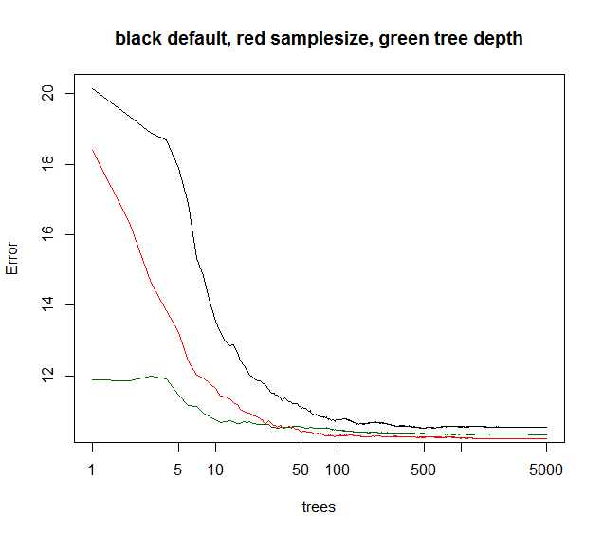

Slide 28
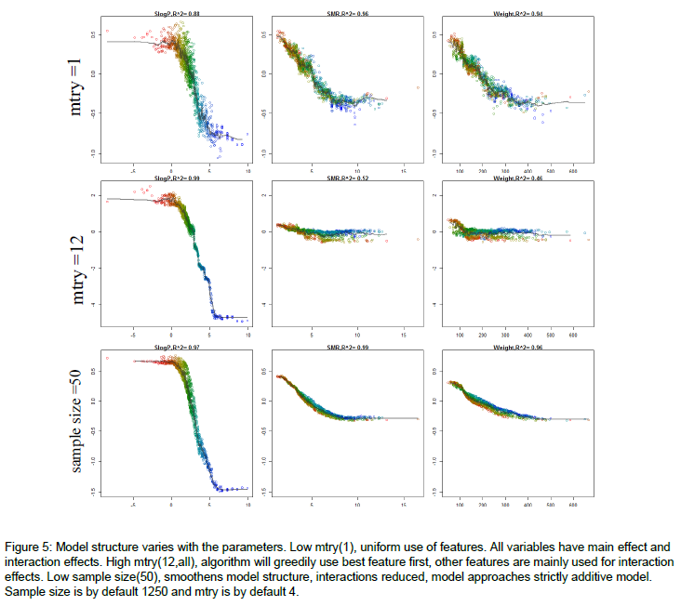

Slide 29
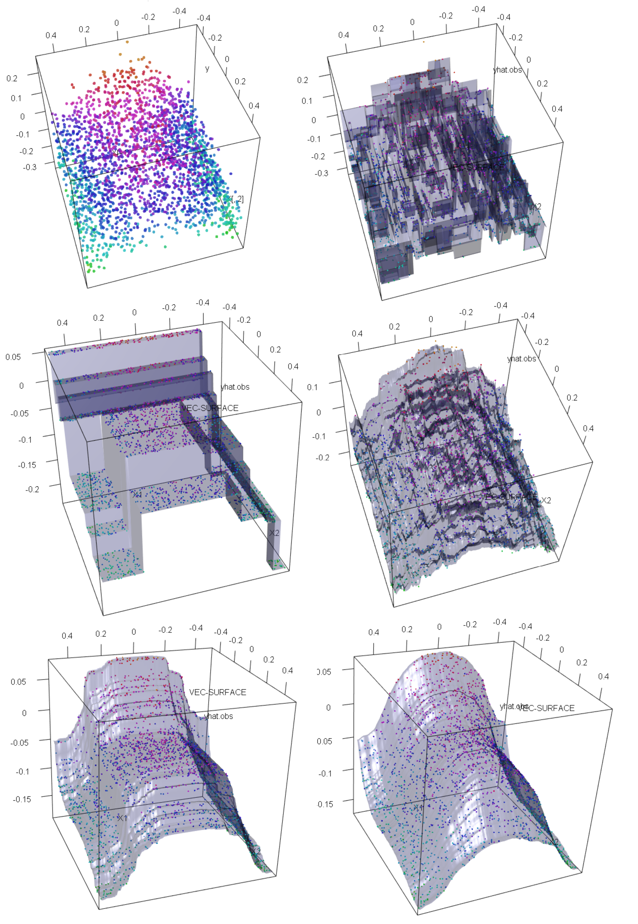
Different kinds of regularization

Slide 30


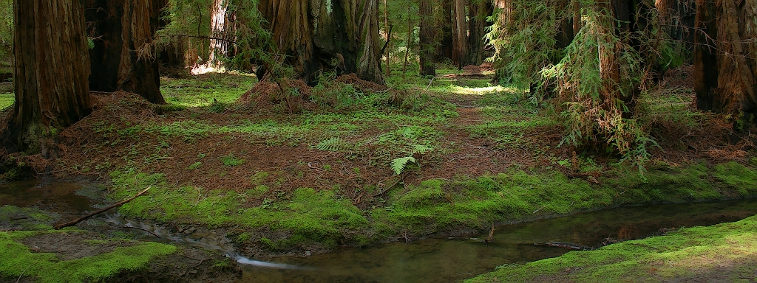
forestFloor
Seeing the curvature of the random forest
Søren H Welling, Line K Clemmensen, Lars Hovgaard, Per Brockhof, Stephen T Buckley, Hanne F Refsgaard

Slide 31
How to learn from the machine
Sample
data
Have machine
to model data
Unknown
system
Learn from
model
Bottom-up model selection
Unknown
system
Sample data
Fit e.g.
linear regression
Look at residuals
Add more terms or transformations
Test hypotheses of G
Simple model
Best model
G

Slide 32


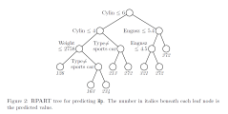
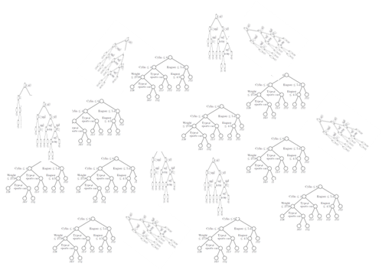

Slide 33
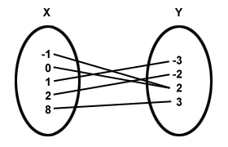
Architecture vs mapping
View tree

Slide 34
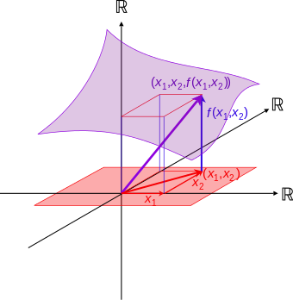
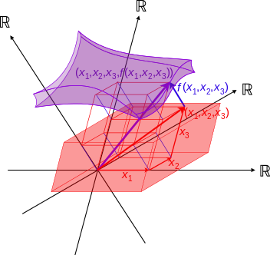
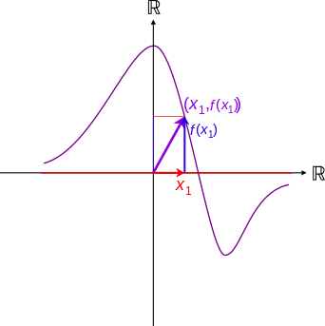
Visualizing mapping
2D
3D
4D

Slide 35
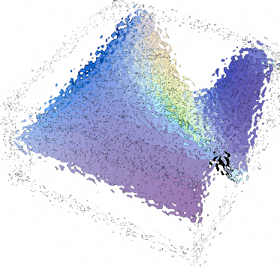
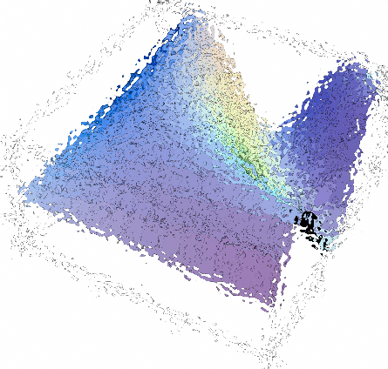
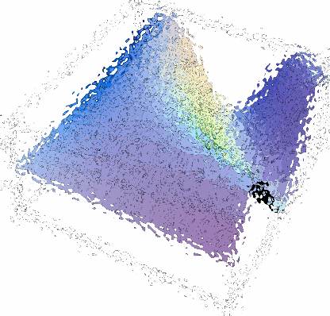
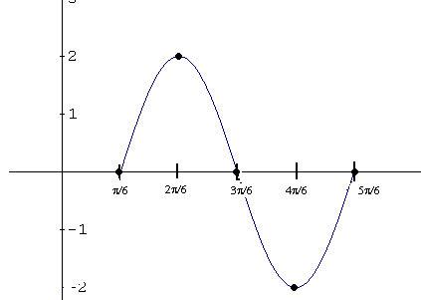
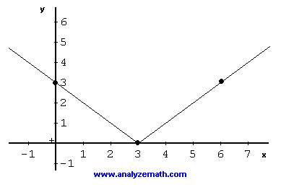
splitting model map in components
h₁(x₁)
h₂(x₂)
P+1 dimensions
=
+
+ …
x₁
x₂
algorithm finds h_{i} such that…
Main effects: f(X) = ∑_{p}h_{i}(x_{i}) + J_{o>1} (X)

Slide 36
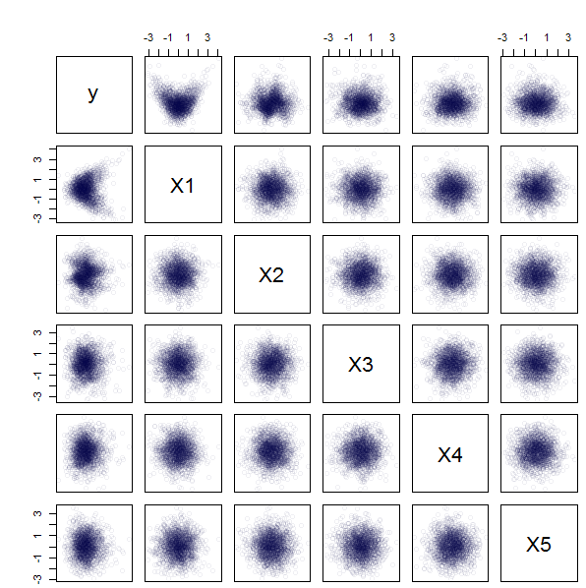
Dear algorithm, figure this one out

Slide 37
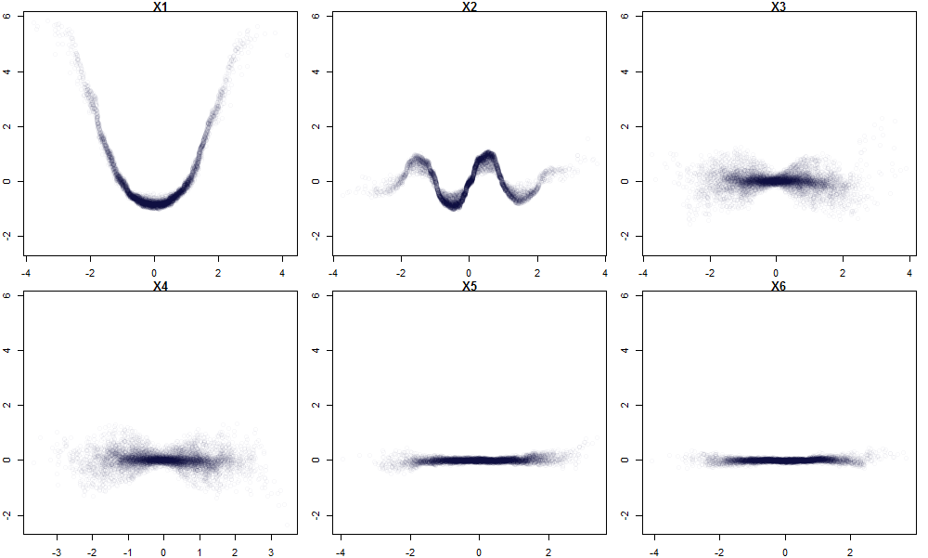
The solution is…
$Y=G^{∗}\left(X\right)={\left(x_{1}\right)}^{2}+sin\left(x_{2}\right)+ \left(x_{3} ∙ x_{4}\right)+{0x}_{5}+0x_{6}$ + noise
x₁²
sinx₂
X₃(x)₄
X₄(x)₃

Slide 38
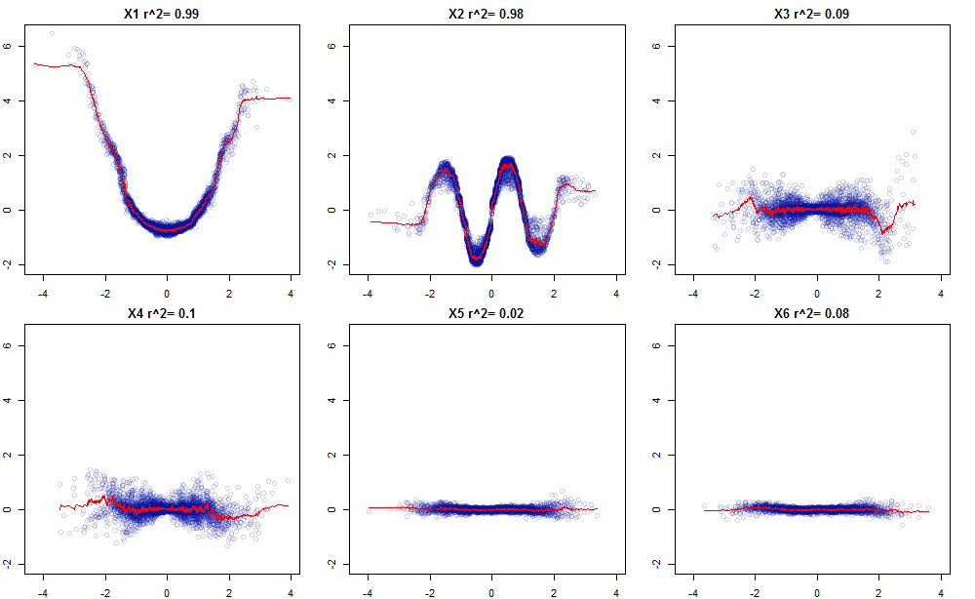

Slide 39
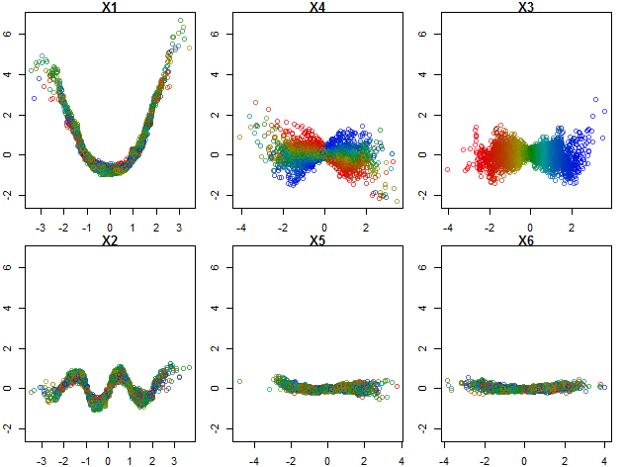

Slide 40
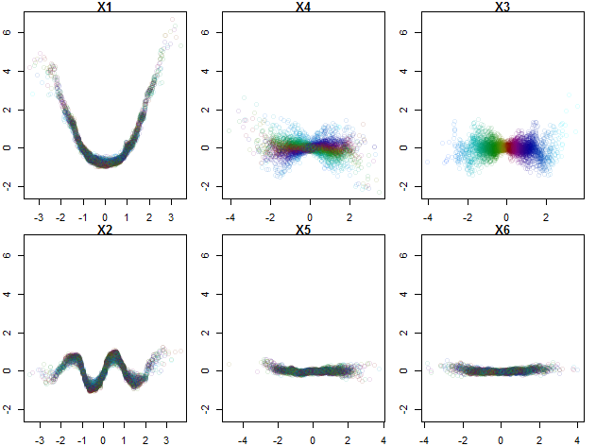

Slide 42
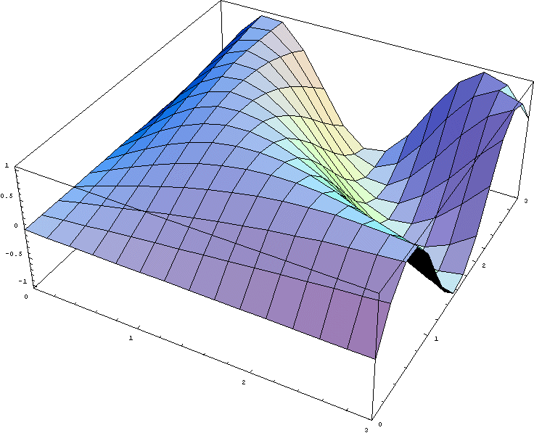
splitting model map in components
h₂₄(x_{2,} x₄)
h₁₂(x_{1,} x₂)
h₁₃(x_{1,} x₃)
=
+
+
2nd order effects: f(X) = ∑_{p}∑_{p}h_{ij}(X_{ij}) + J_{o>2} (X)

Slide 43
Don’t worry the mapping is rarely that complex
Less likely
f(X) = ∑_{p} ∑_{p}∑_{p}h_{ijk}(X_{ijk}) + J_{o>3} (X)
…because N<10.000
…and random forest is not that flexible

Slide 44
How are the individual components estimated?

Slide 45
ū₇=12
n= 52
ū₁=0.14
n=200
10
ū₃=10
n=82
X1 <= 0.8
X1 > 0.8
X₂ <= 1
X₂ > 1
ū₂=-7
n=118
ū₃=10
n=82
ū₆=6.5
n= 32
X₁ > 0.25
X₁ <= 0.25
X₁ <= 0.8
X₁ > 0.8
X₂ > 1
X₂ <= 1
ū₁=0.14
n=200
ū₆=6.5
n= 32
ū₇=12
n= 52
0
ū₄=-10
n=67
ū₅=-3
n=51
obs | X1 | X2 | FC1 | FC2 | Y
1 (LL) | 0.1 | 0.1 | -3-(-7) = 4 | -7-0.14 = -7.14 | 0.14+4-7.14 = -3
2 (UR) | 0.9 | 0.9 | 12-10 = 2 | 10-0.14 = 9.86 | 0.14+2+9.86 = 12
3 (UL) | 0.1 | 0.9 | 6.5-10 = -3.5 | 10-0.14 = 9.86 | 0.14-3.5-9.86 = 6.5
4 (LR) | 0.9 | 0.1 | -10-(-7) = -3 | -7-0.14 = -7.14 | 0.14-3-7.14 = -10
ū₅=-3
n=51
ū₂=-7
n=118
X₁ <= 0.25
X₁ > 0.25
-10
ū₄=-10
n=67

Slide 46
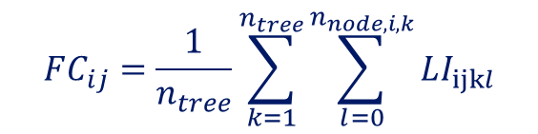
$$FC_{ij}=\frac{1}{n_{tree}}\sum_{k=1}^{n_{tree}}{\sum_{l=0}^{n_{node,i,k}}{LI_{ijkl}}}$$
Feature contribution, FC
Local increment, LI
Any sample, i
Any variable, j
Any tree, k
Any node of the i’th pathway in the
K’th tree, l

Slide 47
Sample
data
Have machine
to model data
Unknown
system
Look at main effects
Identify interactions
With colour gradient
Plot interactions
when needed

Slide 48
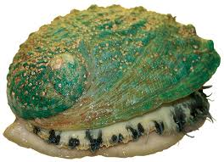
Y:
Rings / integer / -- / +1.5 gives the age in years
Model precision +/- 3 years
But how?
X: Sex / nominal / M, F, and I (infant) Length / continuous / mm / Longest shell measurement Diameter / continuous / mm / perpendicular to length Height / continuous / mm / with meat in shell Whole weight / continuous / grams / whole abalone Shucked weight / continuous / grams / weight of meat Viscera weight / continuous / grams / gut weight (after bleeding) Shell weight / continuous / grams / after being dried

Slide 49
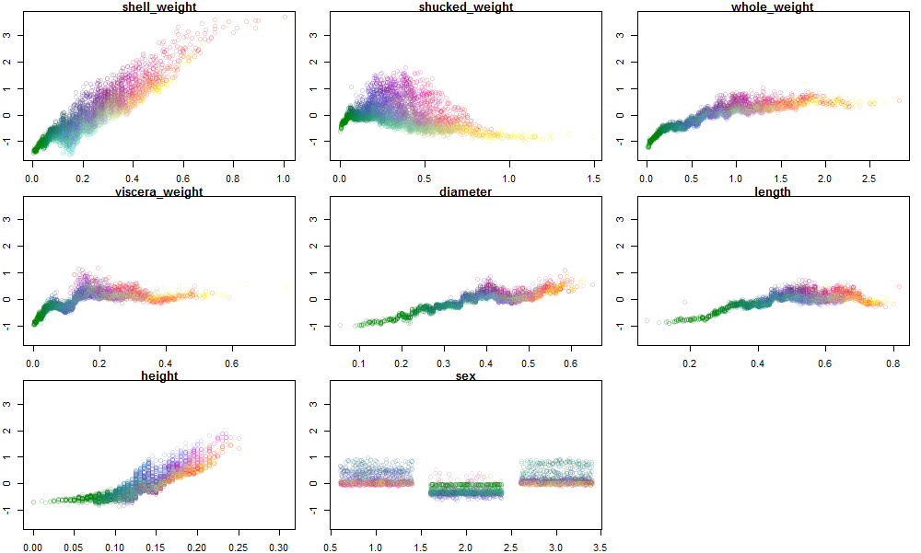

Slide 50
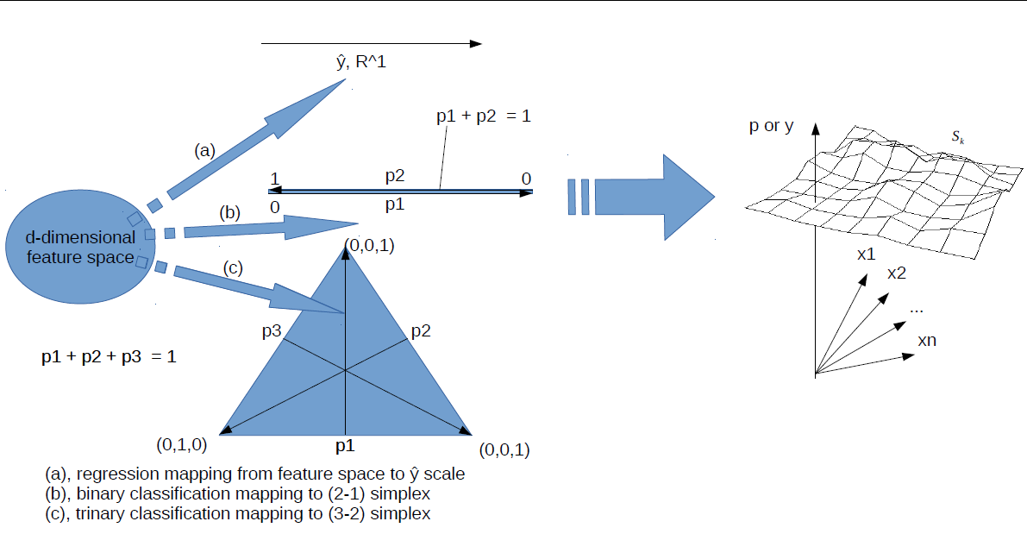

Slide 51
https://archive.ics.uci.edu/ml/datasets/Wine+Quality
library(forestFloor)
library(randomForest)
library(rgl)
data(wwq)
X = wwq[,-12]
Y = wwq[, 12]
rfo = randomForest(X,Y,keep.inbag=T,importance=T)
ff = forestFloor(rfo,X)
plot(ff)
plot(ff,col=fcol(ff,1,alpha=0.3),cropX=c(2,4,5,9))
plot(ff,c(1,3),col=fcol(ff,1,alpha=0.1),cropX=3)
show3d(ff,c(1,3),col=fcol(ff,c(1),alpha=0.3),zoom=2)

